Slide 1
Follower Factory
Based on the article by Nicholas Confessore et al.
Presented by Udith Prabhu
For CS895 Fall 2020
Source - https://www.nytimes.com/interactive/2018/01/27/technology/social-media-bots.html
December 10, 2020

Slide 2
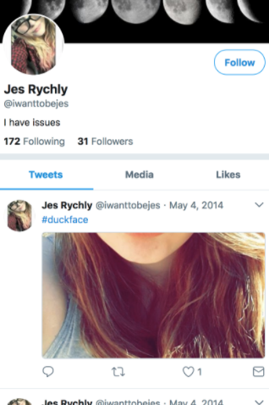
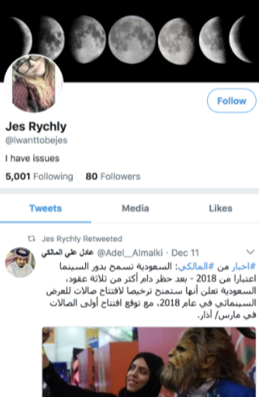
The real Jessica Rychly
The real Jessica Rychly is a teenager from Minnesota who likes reading books and the rapper Post Malone
Another account with the same name, same bio and same profile picture is available on Twitter.
The other account promotes crypto currency, a radio station in Ghana and sometimes tweets in Arabic and Indonesian.
The other account was created by Devumi
https://www.nytimes.com/interactive/2018/01/27/technology/social-media-bots.html
“Follower Factory” Based on https://www.nytimes.com/interactive/2018/01/27/technology/social-media-bots.html #cs895f20

Slide 3

Devumi is a company that sells ghost followers
https://web.archive.org/web/20151006191910/https://devumi.com/
“Follower Factory” Based on https://www.nytimes.com/interactive/2018/01/27/technology/social-media-bots.html #cs895f20

Slide 4
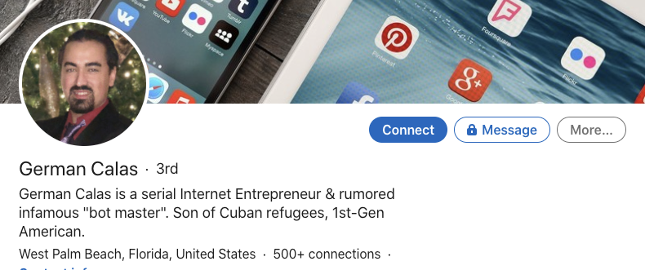
“Bot Master” German Calas - Founder of Devumi
https://www.linkedin.com/in/german-calas/
“Follower Factory” Based on https://www.nytimes.com/interactive/2018/01/27/technology/social-media-bots.html #cs895f20

Slide 5
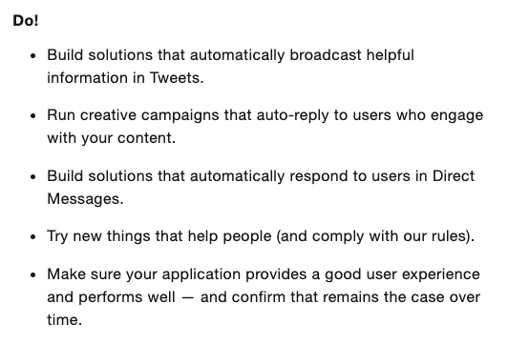
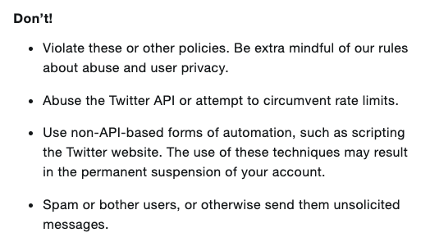
Do’s and Don’ts of automating Twitter
https://help.twitter.com/en/rules-and-policies/twitter-automation
“Follower Factory” Based on https://www.nytimes.com/interactive/2018/01/27/technology/social-media-bots.html #cs895f20

Slide 6
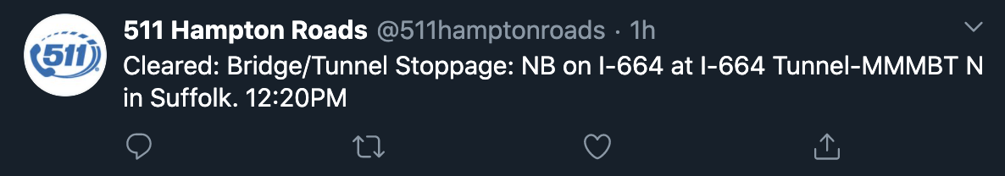
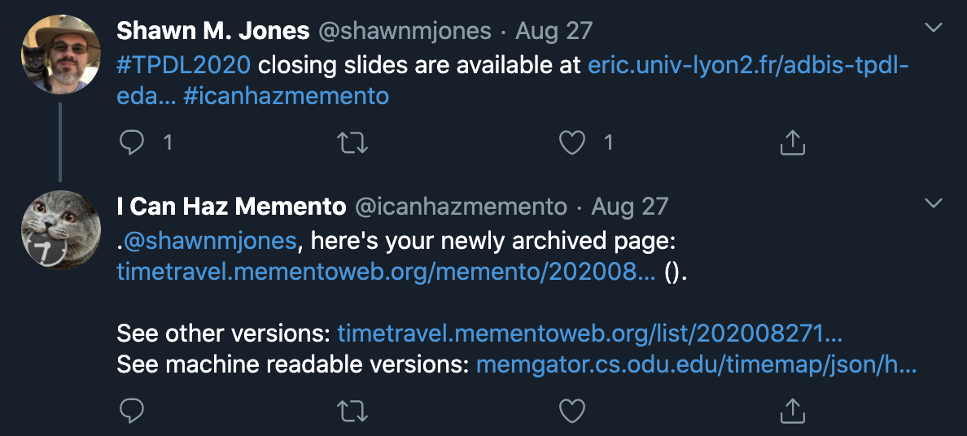
Benign bots
https://twitter.com/511hamptonroads/status/1337084735655436288
https://twitter.com/icanhazmemento/status/1298998936447803397
“Follower Factory” Based on https://www.nytimes.com/interactive/2018/01/27/technology/social-media-bots.html #cs895f20

Slide 7
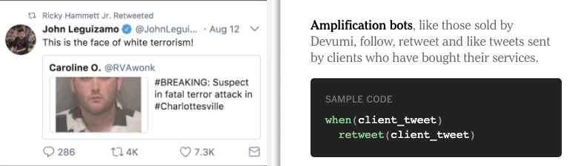
Devumi’s bots
https://www.nytimes.com/interactive/2018/01/27/technology/social-media-bots.html
“Follower Factory” Based on https://www.nytimes.com/interactive/2018/01/27/technology/social-media-bots.html #cs895f20

Slide 8
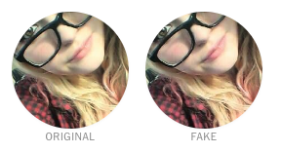
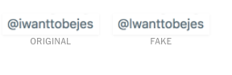
Color shifting and substitution to avoid detection
Image processing techniques like color-shifting and recompression was done to the image, possibly to avoid automated detection
Small changes were made to the handle so that the difference will not be noticed by a cursory look
https://www.nytimes.com/interactive/2018/01/27/technology/social-media-bots.html
“Follower Factory” Based on https://www.nytimes.com/interactive/2018/01/27/technology/social-media-bots.html #cs895f20

Slide 9
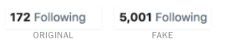
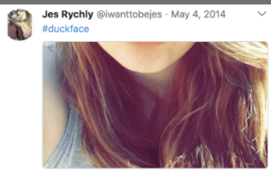

Metric difference between the real and fake account
The fake accounts follow more than 10 times the amount of users followed by the real account. This is to be expected as the company reuses the same accounts for multiple clients
The bot accounts also retweeted from a wide range of accounts about a wider spectrum of information. This is highly unlikely incase of an actual user.
https://www.nytimes.com/interactive/2018/01/27/technology/social-media-bots.html
“Follower Factory” Based on https://www.nytimes.com/interactive/2018/01/27/technology/social-media-bots.html #cs895f20

Slide 10
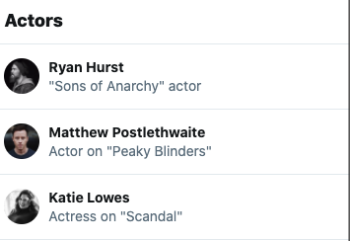
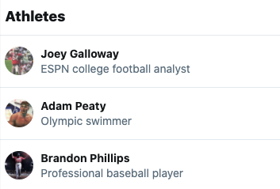
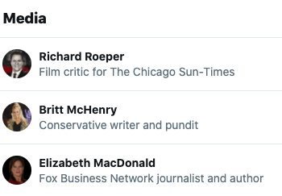
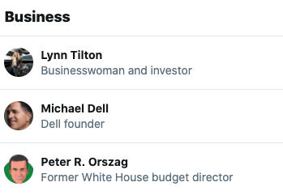
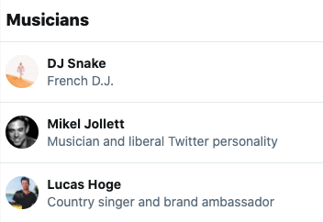
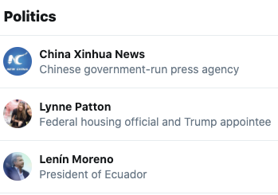
Scope of deception
https://www.nytimes.com/interactive/2018/01/27/technology/social-media-bots.html
“Follower Factory” Based on https://www.nytimes.com/interactive/2018/01/27/technology/social-media-bots.html #cs895f20

Slide 11
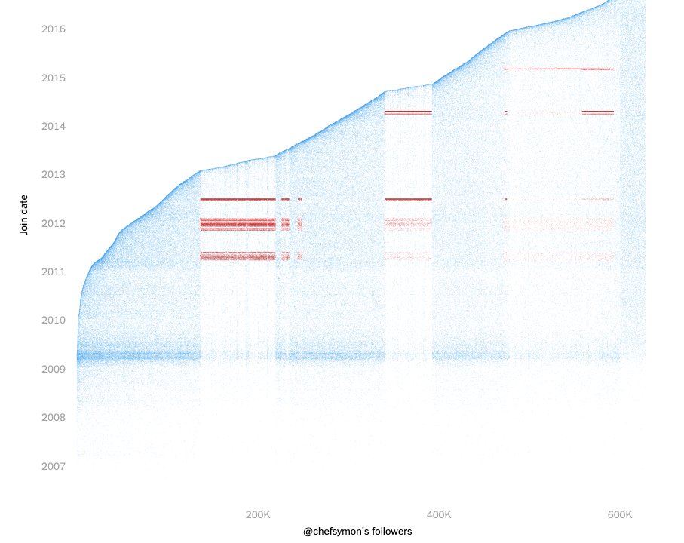
Celebrity chef, Michael Symon, is a Devumi client
Normal Account
Bot Account
https://www.nytimes.com/interactive/2018/01/27/technology/social-media-bots.html
“Follower Factory” Based on https://www.nytimes.com/interactive/2018/01/27/technology/social-media-bots.html #cs895f20

Slide 12
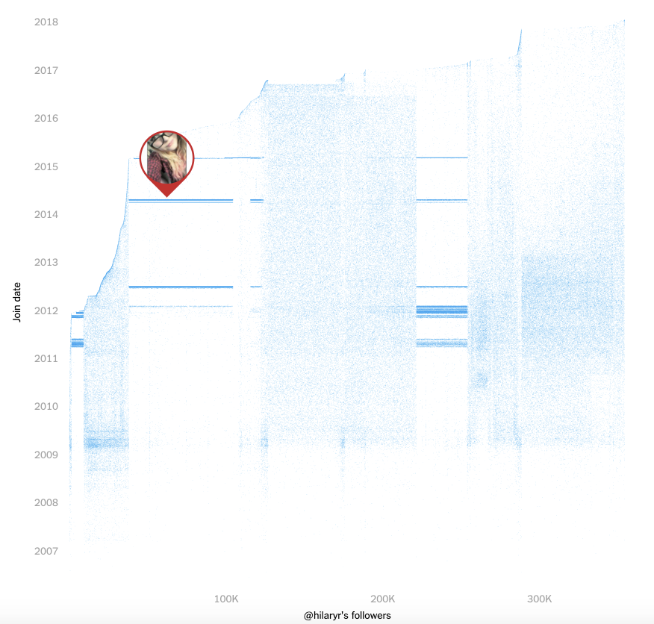
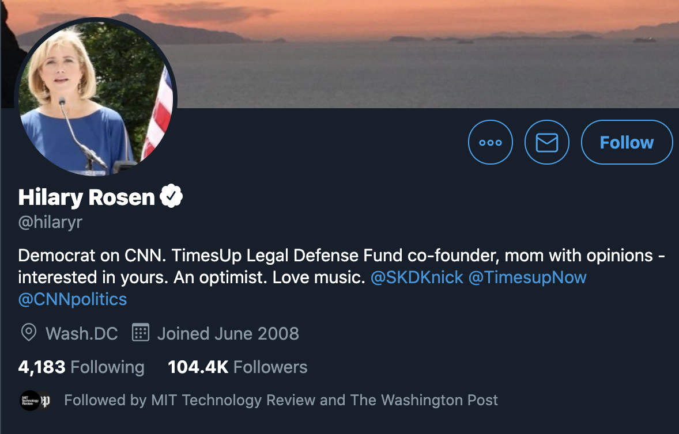
Political commentator, Hilary Rosen, paid for 0.5M+ Twitter followers
https://twitter.com/hilaryr
https://www.nytimes.com/interactive/2018/01/27/technology/social-media-bots.html
“Follower Factory” Based on https://www.nytimes.com/interactive/2018/01/27/technology/social-media-bots.html #cs895f20

Slide 13

Devumi’s office address was fake
https://www.nytimes.com/interactive/2018/01/27/technology/social-media-bots.html
“Follower Factory” Based on https://www.nytimes.com/interactive/2018/01/27/technology/social-media-bots.html #cs895f20

Slide 14
Truth and lies associated with Devumi
Devumi listed address in in Manhattan.
Devumi is actually based in an office suite above a Mexican restaurant in Florida.
Devumi’s founder, German Calas, has listed in his resume that he holds Ph.D from MIT.
Representative from MIT has denied the claim.
German Calas listed in his resume that he attended Princeton in 2000, when he would have been 10 years old.
Representative form Princeton has also denied this claim
German Calas listed in his LinkedIn page that he has a Master’s degree in International Business from MIT.
MIT does not offer such a degree.
“Follower Factory” Based on https://www.nytimes.com/interactive/2018/01/27/technology/social-media-bots.html #cs895f20

Slide 15
The bot supply chain
Peakerr
Devumi
CheapPanel
Customers like Michael Symon
YTbot
Devumi Boost
Other bot providers
“Follower Factory” Based on https://www.nytimes.com/interactive/2018/01/27/technology/social-media-bots.html #cs895f20

Slide 16
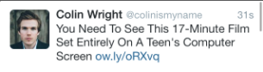


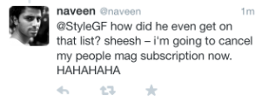
Evolution of Twitter’s UI which facilitated raise of Devumi
Twitter has continuously updated its UI to facilitate higher engagement.
This has increased the user’s need for higher metrics
Thus, the users have turned to Devumi and the companies bots to satisfy the need
September 2013
February 2014
June 2014
October 2013
https://www.nytimes.com/interactive/2018/01/27/technology/social-media-bots.html
“Follower Factory” Based on https://www.nytimes.com/interactive/2018/01/27/technology/social-media-bots.html #cs895f20

Slide 17
Twitter bot purge
Twitter suspended more than 59 million accounts in the span of 3 months from October 2017 to Dec 2017
In the months of May through June 2018, Twitter suspended another 70 million accounts.
The company did not respond to questions regarding the reason for the purge.
After the purge, Twitter lost around 7.7 million followers, thus becoming the most affected party of the purge
Source 1: https://www.forbes.com/sites/kalevleetaru/2018/07/21/twitters-great-bot-purge-and-can-we-really-trust-active-user-numbers/
Source 2: https://www.marketwatch.com/story/who-lost-the-most-followers-in-twitters-sweeping-bot-purge-twitter-2018-08-01
“Follower Factory” Based on https://www.nytimes.com/interactive/2018/01/27/technology/social-media-bots.html #cs895f20

Slide 18
Key Takeaways
Fake accounts based out of real people, people like Jessica Rychly, are being used as “high quality” bots
Twitter has taken a more reactive approach rather than a proactive one in combating the increase in bot accounts till the middle of 2017.
Twitter and other social media companies have also introduced highly engaging mechanisms like real-time metrics update, which feeds into the increasing use of bots.
Companies like Devumi outsource the bots that are used.
From the end of 2017 to the middle of 2018, 129 million bot accounts were purged by Twitter. The simple magnitude of the bots found and the uncountable others that are still present reveals the true enticement that cheap ways to increase the user’s metrics hold for social media users.
“Follower Factory” Based on https://www.nytimes.com/interactive/2018/01/27/technology/social-media-bots.html #cs895f20

